Slide 1
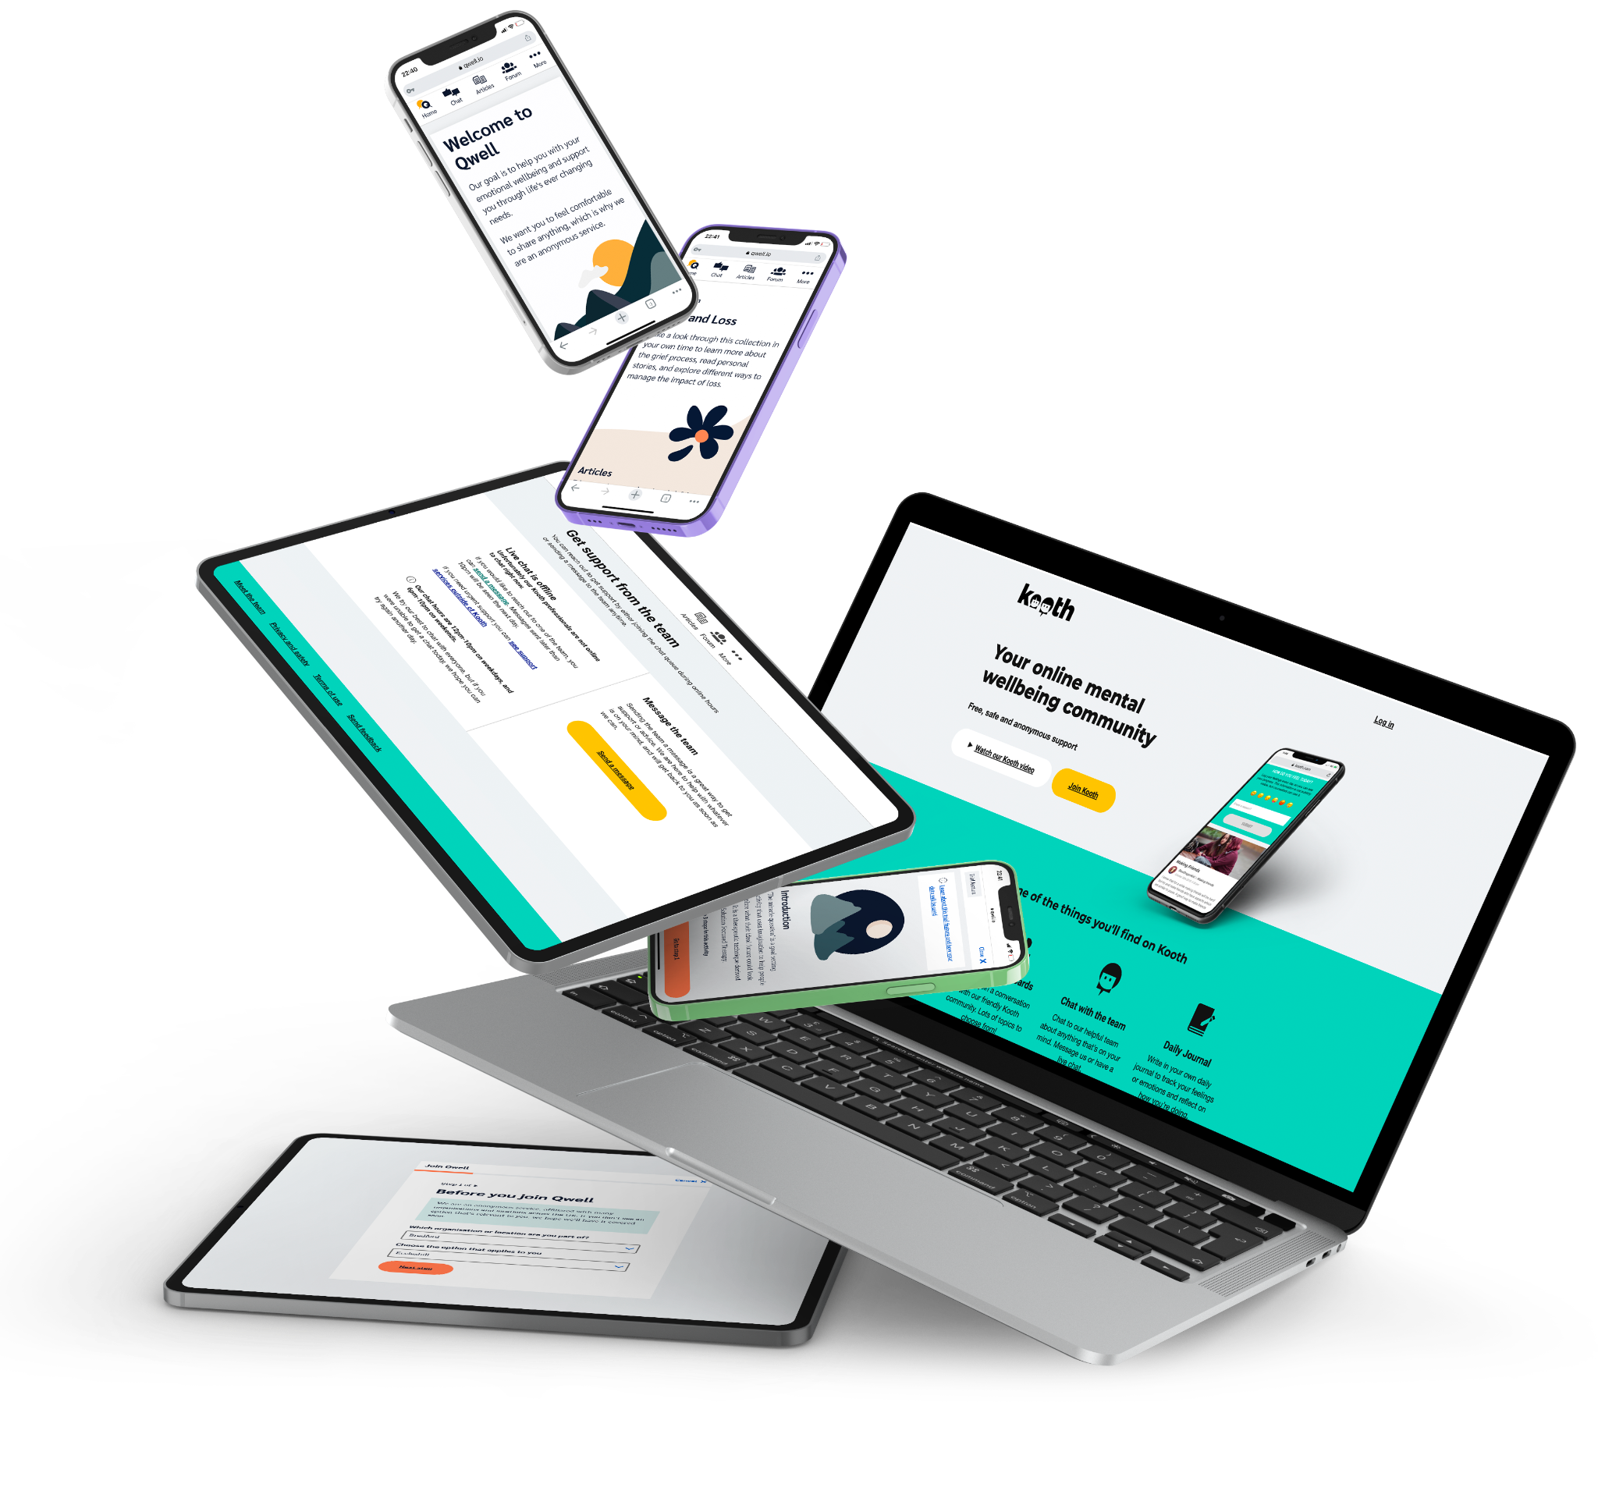
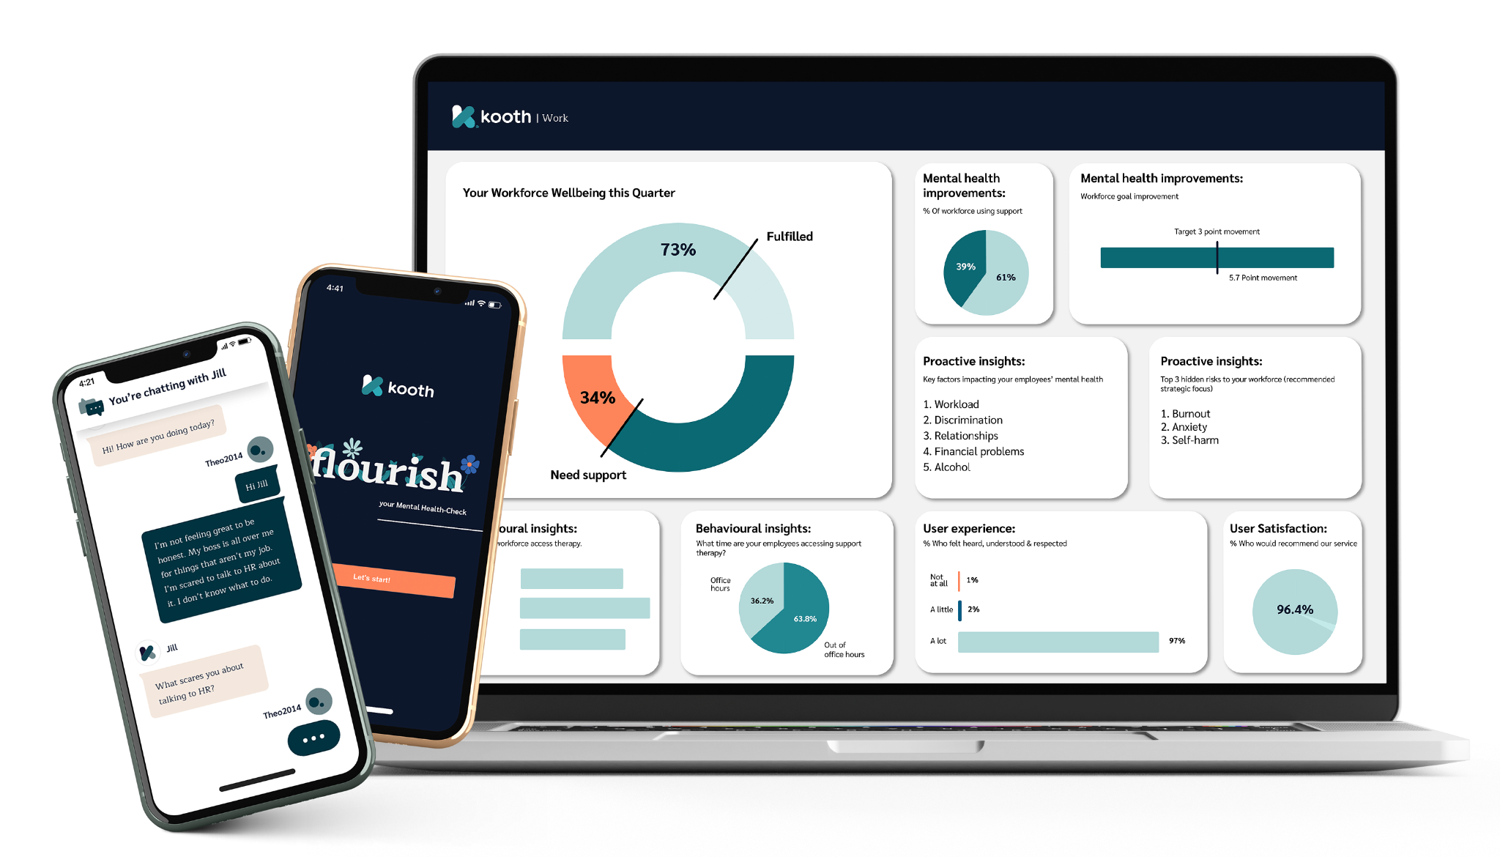
Mental wellbeing example KPI dashboard Prevention and early intervention
Review period: [e.g. last 12 months]

Slide 2
Instructions
Use this example to identify your KPIs and their targets
Adapt these based on your organisation
KPIs should be relevant to your SMART objectives and your support options
How frequently will you formally review these KPIs: monthly, quarterly, or annually?
Refer to the manual for more information.

Slide 3
Example mental wellbeing KPIs dashboard
Category | KPI and performance target | Designation | Performance
Promotion of mental health | 1 company-wide employee engagement initiative every 2 months to raise awareness and discussion around the top presenting issue with signposting to support options | Preventative
Percentage of employees actively using the platform | X% of staff accessed the digital support platform over Y time period | Preventative
Employee wellbeing communities holding regular meetings | X community events hosted for employees over Y time period | Preventative
Preventing burnout | X% of employees with a low burnout risk rating over Y time period (Copenhagen Burnout Inventory) | Preventative
Preventing depression | Maintain below 1% of employees within high risk of depression over Y time period (WHO-5) | Preventative
Employees Flourish score | Maintain over X% of employees within the ‘Flourishing’ status over Y time period (Flourish Scale) | Preventative
Minimising the risk of leaving | Maintain below 3% of employees within high risk of leaving over Y time period (Utrecht Work Engagement Scale) | Preventative
Accessibility of support | X% of employees surveyed understand the support available to them and where to access it over Y time period | Preventative
Absence levels due to mental health | Maintain less than X days absence per person due to mental health reasons over Y months | Reactive
Employee leavers due to mental health | Maintain less than X % of staff leaving due to mental health reasons over Y months | Reactive
Employee feedback | Employees rating their happiness at X/10 or higher over Y time period | Reactive
Employees needing emergency support | X % of staff who needed access to emergency mental health support over Y months | Reactive
Other…

