Slide 1
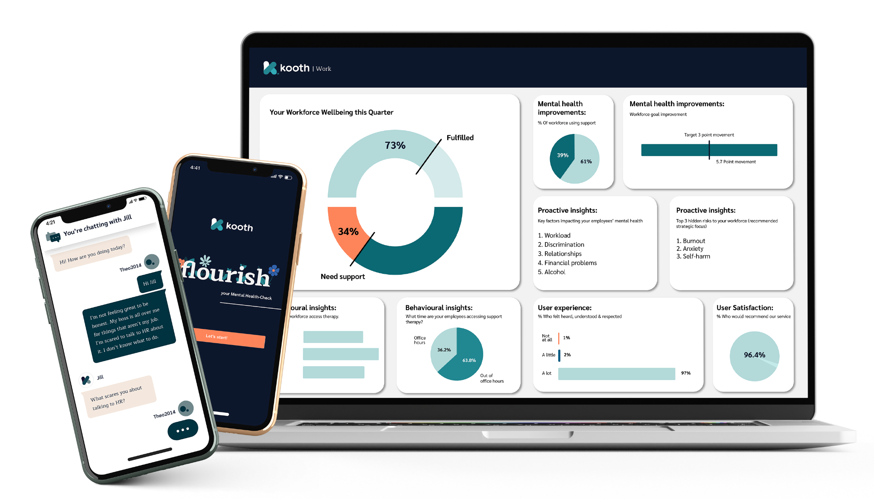
Mental wellbeing evaluate and map support options Prevention and early intervention
Review period: [e.g. last 12 months]

Slide 2
Instructions
Compare back in relation to the mental wellbeing needs and gaps you identified in the UNDERSTAND section.
Use the grids to compare and evaluate the different options:
Digital mental wellbeing options
In-person mental wellbeing options
Employee benefits mental wellbeing options
Plot your support options into the grid, differentiating between ‘Preventative and early intervention’ and ‘Reactive and emergency support’
Look for in-balances in support.
Refer to the manual for more information.

Slide 3
Digital options comparison and evaluation
Name of potential digital option: [add here] | Notes
What is the standard of clinical expertise and resources available and the evidence behind the support?
What is the range of support available within the platform?
Is it an app or an anonymous digital platform?
Is it accredited by a recognised body e.g. BACP?
What levels of acuity can it handle?
What are the therapeutic support options?
Does it provide fast access to a professional mental health practitioner?
What level of reporting does it provide?
Can it integrate / refer in and out into your other options?
What outcomes would be achievable?
Where does it fit in your ecosystem?
What is the cost per person/use?

Slide 4
In-person options comparison and evaluation
Name of potential digital option: [add here] | Notes
Provided in-house or third party?
What is the standard of clinical expertise and resources available - what is the evidence behind the support?
What is the range of support within the option?
Is it accredited by a recognised body e.g. BACP?
What levels of acuity can it handle?
What are the therapeutic support options?
Does it provide fast access to a mental health practitioner?
What level of reporting does it provide?
Can it integrate / refer in and out into your other options?
What outcomes would be achievable?
Where does it fit in your ecosystem?
What is the cost per person/use?

Slide 5
Employee benefits options comparison and evaluation
Name of potential digital option: [add here] | Notes
Provided in-house or third party?
What is the evidence behind the option?
What outcomes would be achievable?
Where does it fit in your ecosystem?
What is the cost per person/use?

Slide 6
Map your mental wellbeing support options
 | Preventative and early intervention | Reactive and emergency support
Digital support options | Add selected options here | Add selected options here
In-person support options | Add selected options here | Add selected options here
Employee benefits options | Add selected options here | Add selected options here

